Slide 1
The Virtual Reality Design Review Application 2.0
Application Functionality Demands

Slide 2
The end goal for the Application
Modernize and digitalize the design review workflow
Make information more organised by having it present directly in a 3D model
Improve collaboration and communication between designer and approval engineer
E.g by showing them areas of attention in the model during a virtual design review meeting
Keep a history of all the changes made to the design and the 3D model
Make the work done during the design phase more accessible during surveys
Improve 3D perception and interaction with virtual reality- and gesture recognition technology
To enable this, support for several functional areas need to be added.
We are here to discuss which to prioritize.

Slide 3
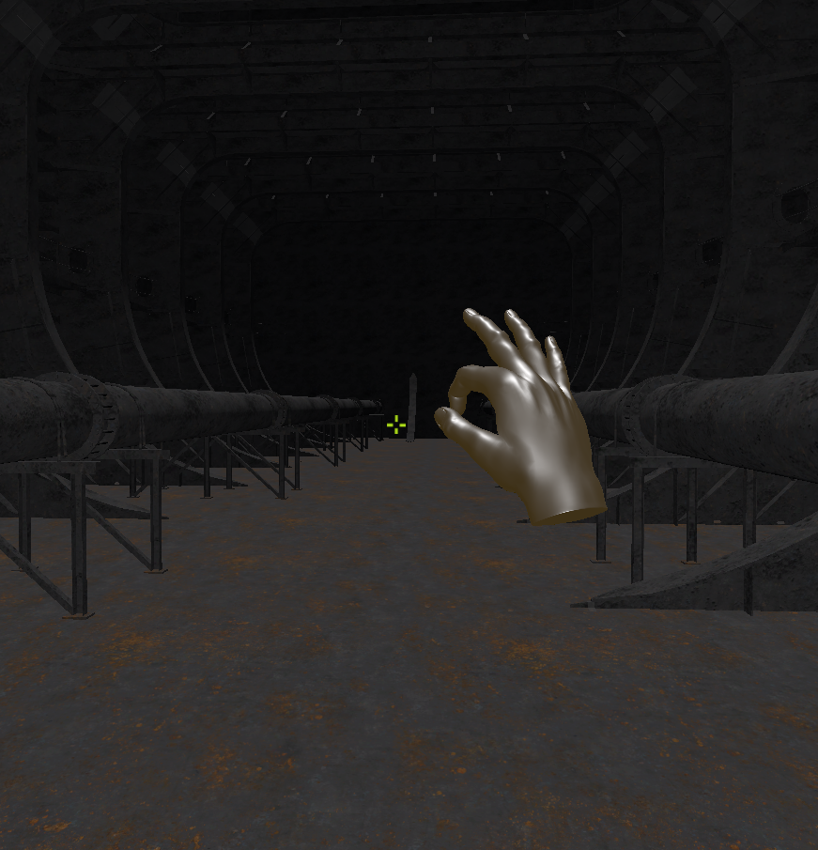
Functionality 1: Navigate a 3D model
To be able to navigate the 3D model in a first-person view using either mouse and keyboard or gestures.
Implemented!

Slide 4
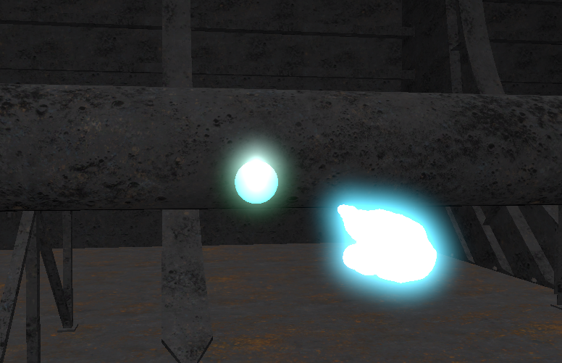
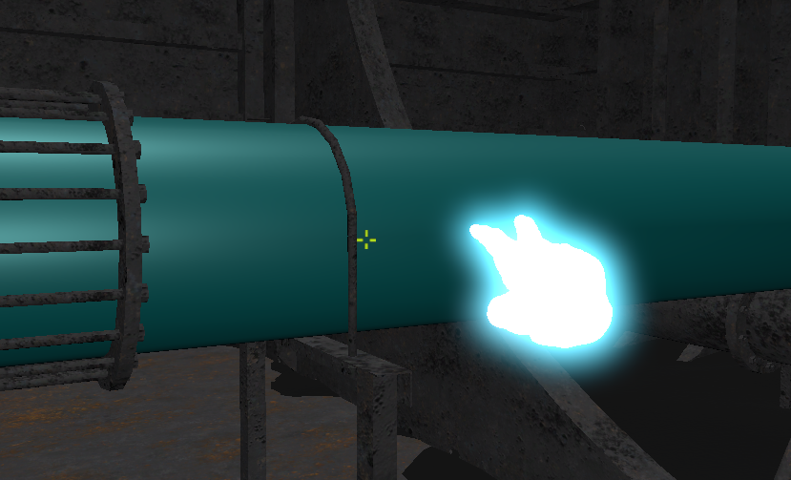
Functionality 2: Create annotation
To be able to create annotations, which can store information related to the annotations position or the object it is attached to.
The user should be able to create either “point-annotations” or “object-annotation”.
Implemented!

Slide 5
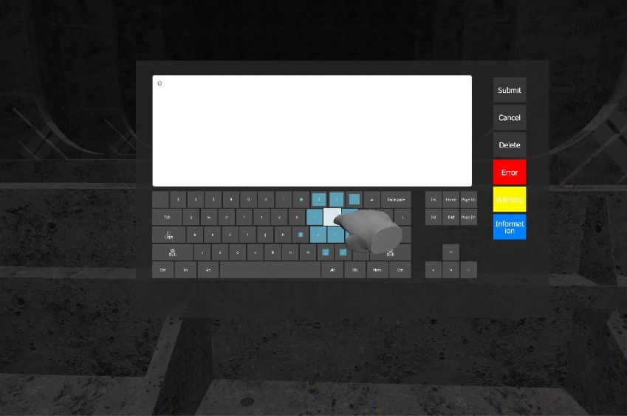
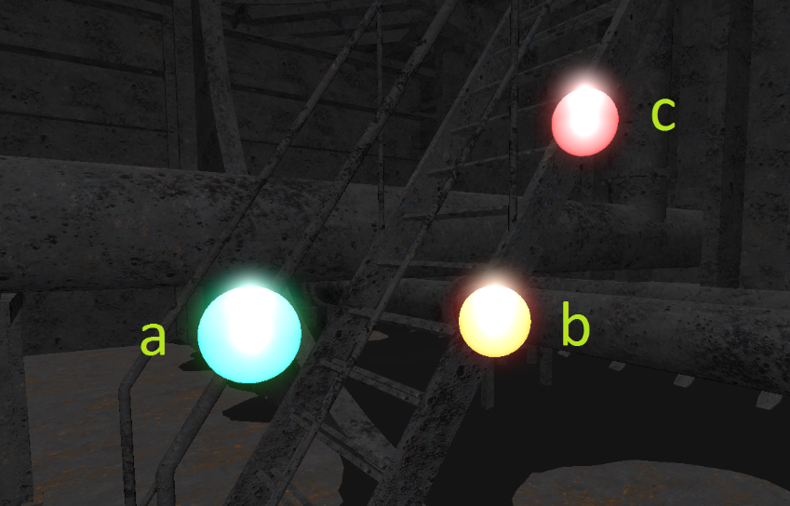
Functionality 3: Edit annotations
To be able to edit the annotations. This should include writing an associated text and setting a priority. The priority should be indicated by colouring the annotation differently.
Although somewhat impractical, edits of annotations should also be possible by only using gestures.
Implemented!

Slide 6
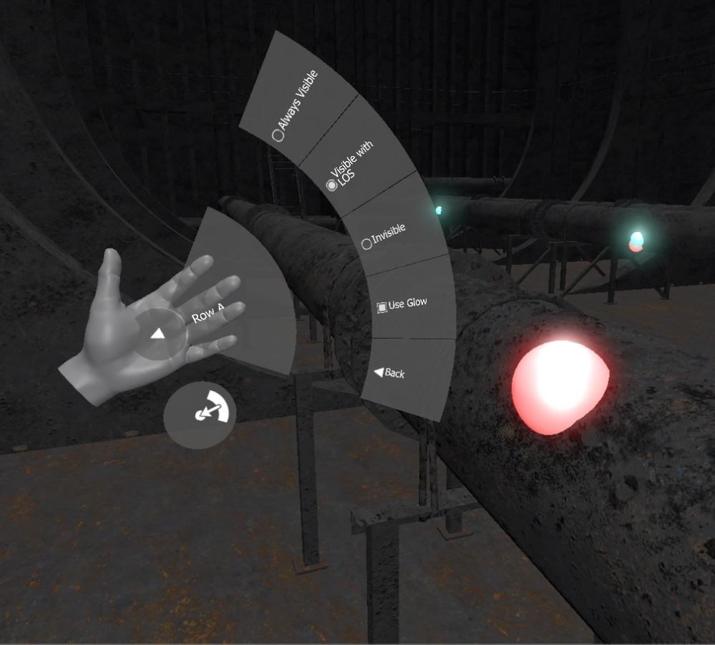
Functionality 4: Enable several options through a menu
To be able to select between several options related to how the applications functions.
Examples of options includes:
Choosing between having separate gesture for movement along the x-, y- and z-axis, or having this combined in one gesture.
Annotation visibility levels
Temporary disable gestures
Implemented!

Slide 7
The way forward
This recaps the functionality that was added during the master’s thesis and, in short, enables a user to move around a 3D model and create basic annotations.
However, to reach our end goal – outlined in our introductory slide – a lot more functionality is needed. In short we need:
To be able to select the 3D model we want to use.
Host a meeting in this model, which enables other users to join the review*.
Annotations to persist between sessions/meetings* (a save and load mechanism)
Expose the annotations in other formats as well (e.g export a list of annotations to a pdf- or doc file).
*Note that we differentiate between “review” and “session/meetings”. Here review refers to an initiated instance of a review on a model, while session and meeting both refer to the finite time where the review is active (i.e when people are loaded into the model).

Slide 8
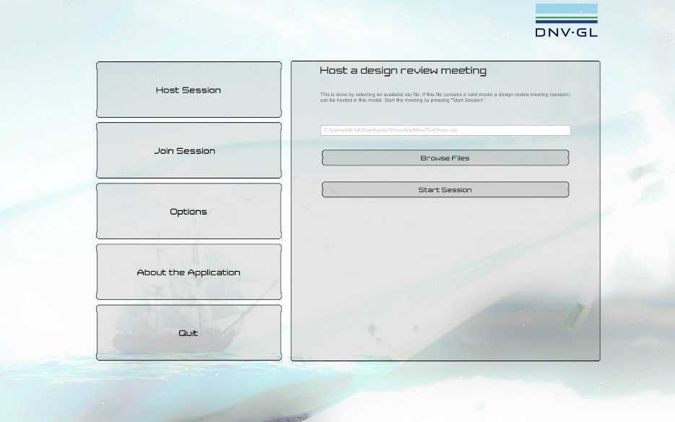
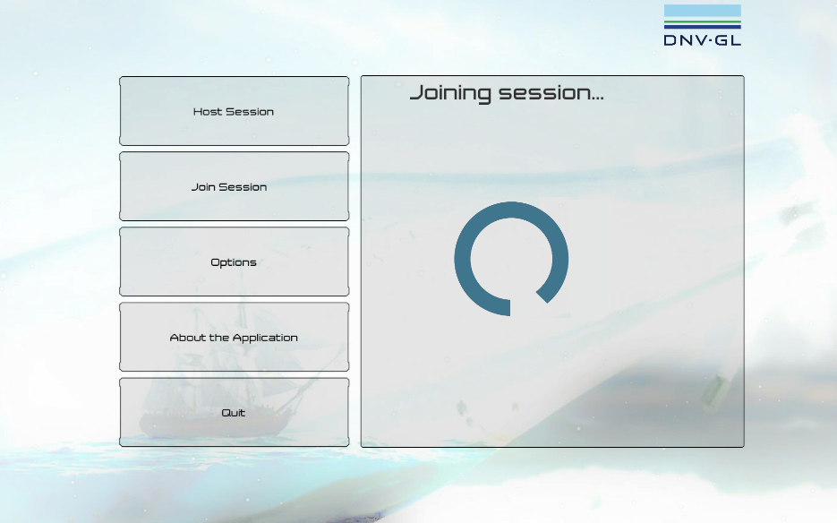
Functionality 5: Selecting the 3D model
The user should be able to specify what model he or she would like to host design review in. This should be done by e.g a file browser where the model is selected.
Once a model is selected, and a design review is created for that model, the session can be started by pressing “Start Session”.
I’ve done some of this already, but some things remain (e.g handling models with more than 65 000 vertices).
Partially implemented!

Slide 9
Functionality 6: Enabling multiple users in a meeting
Several users should be allowed to enter a design review. These design review participants should be able to interact with the model, see representations of each other and see each other’s actions.
To enable multiple users to be present in the 3D model we need some network functionality. We can either host the sessions on a dedicated server, or use peer-to-peer- technology, where the host’s computer acts as the server.
The latter is arguably the best to start with as it doesn’t require us to have the application running on a server, and having a dedicated server environment for it.
Estimated development time (one developer): 10 days.

Slide 10
Functionality 7: Storing and restoring annotations
To enable annotation to persist between sessions, they should be saved, either periodically or when the user exits the application, and then restored when that design review is continued at a later time. This can be done is several ways, e.g:
Store annotations in the model file itself (not advisable)
Store annotations in a separate file (e.g a JSON file)
Store annotation in a database (the most robust, but also the most complex).
Of these I recommend the 2nd option.
The development of this can take place in two phases:
Only save the file locally, e.g in the same folder were the model is located. When is continued search for this file.
Store the file on a web server (“in the cloud”). A more convenient and robust option with a lower chance of annotation-file-conflict.
Estimated development time for option 2: 3 + 4* days. *depends on Func 6.

Slide 11
Functionality 8: Expose annotation to other platforms
To application could make the annotations accessible outside the model, so a designer or approval engineer don’t have to enter the model to read (or edit) the annotations. There are three primary approaches to implement this:
Generate and export an annotation list to file (e.g. txt, doc(x), pdf or xls/csv)
Relatively simple, but read-only.
Create a web-application where annotations can be viewed and edited (e.g in a scrumboard or an issue tracker)
This enables annotations to be written/filled in outside of the application
Much more time demanding to implement than the former.
Interface with an existing web-application system (e.g Jira or Confluence)
I don’t know the difficulties of this, but probably as time demanding as the former.

Slide 12
Functionality 8: Expose annotation to other platforms cont.
Note that with a JSONs-stored-online-solution (see previous slide), we might be able to create some simple interfacing with the JSON files, which would allow the same functionality as mentioned in option 2.
Estimated development times: 2 days (to .txt or csv), 5-? days (to doc or pdf)
This solution can at the minimum simply be to edit the JSON files directly online using a terminal (e.g ssh + vim) (0 days dev time) to a simple JSON-to-HTML and HTML-to-JSON converter (3-5 days), to a fullblown web application (14 days++).
Task | Est. dev. time | Notes
Convert annotation to .txt or .cvs | 2 days
Convert annotations to .doc or .pdf | 6 days | More complex formats
Utilize the online JSON files in a web app | 0 days++* | Depends on func 7.

Slide 13
Allocating time
Lets recap the time requirements:
My estimated number of development days: 20.
# | Functionality | Est. time | Priority
5 | Selecting and loading models | 5 days | High
6 | Multiple users | 10 days | Medium
7 | Saving and loading annotations | 3 + 4 days | High
8 | Exposing annotations | 2/6 days | Low
 |  | = 20 – 29 days

Slide 14
Thank you!
Andreas Oven Aalsaunet
andreas.aalsaunet@gmail.com
+47 913 73 741

